Slide 1
Big Data: The Next Revolution of Sports
Presented by:
Ashish Soni
Gurvinder Singh
Anshul Walia
(MCA)

Slide 2
Introduction:
Big Data –the data that has the potential to be mined/analyzed for valuable information, to optimize performance is transforming modern society.
Sport society is also starting to utilize the potentially huge amounts of data available in the respective different formats.

Slide 3
Big Data: The Winning formula in Sports
Big Data in sports affects two major groups: fans and teams.
For the fans, it has provided a new experience- As one can remain updated consistently with all the news and statistics of the team and individual analyses of each player.

Slide 4


Slide 5


EXAMPLES
(Basketball) the NBA's statistics website, stats.nba.com, has already racked up over 20 million unique views.
The NBA relies on innovative technology to track these statistics. At every game, cameras positioned at various angles record and log the movement of each of the players.
Tennis saw the introduction of the IBM Slam Tracker. This technology aggregated and published a variety of statistics.

Slide 6
For the teams, this new data is a boon. Many teams are now employing a data specialist who is responsible for interpreting advanced statistics.
During training and games, players are now equipped with sensors that monitor every aspect of their performance- from the heart rate and metabolism to reaction time.

Slide 7
In the UK, Premier League soccer team Arsenal has recently invested millions in developing its own analytics team to make better use of the data it is now collecting. One important data stream comes from 8 cameras installed around its stadium to track every player and their interactions.
Now analysis of ‘off ball’ events is of huge interest.

Slide 8
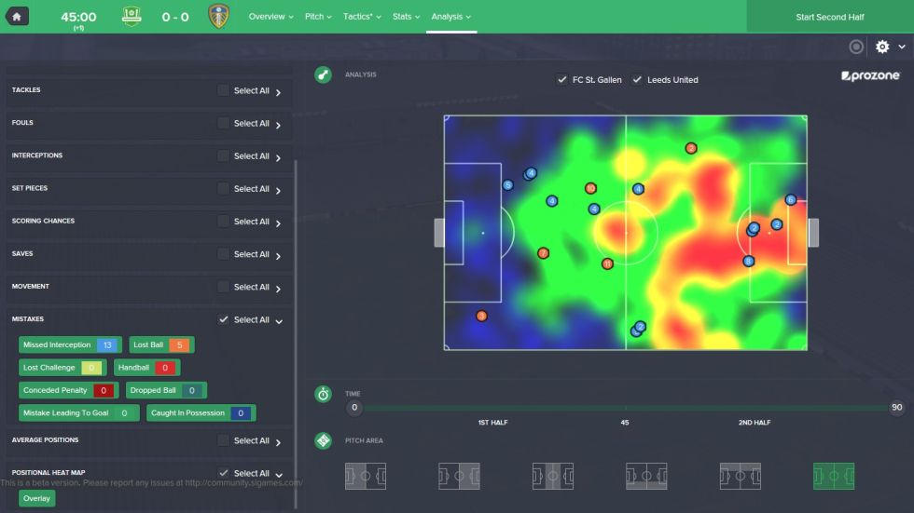

Slide 9

Soccer is among the growing list of sports being transformed by Big Data. The use of data and statistics to gain a competitive advantage has grown across a wide range of sports including basketball, tennis, and baseball etc.

Slide 10
Technologies:
Big data at work with Germany's Football World Cup win:
To gain a competitive edge, the team partnered with German software giant SAP AG to create a custom match analysis tool that collects and analyzes massive amounts of player performance data.
The tool, called Match Insights, analyzes video data from on-field cameras capable of capturing thousands of data points per second, including player position and speed.

Slide 11
The tool also allows coaches to determine performance indicators for individual players, which they can then send to teammates ’ mobile devices.
When it comes to positioning on the field, Match Insights can show the team virtual “defensive shadows” that show how much area a player can protect with his own body.

Slide 12

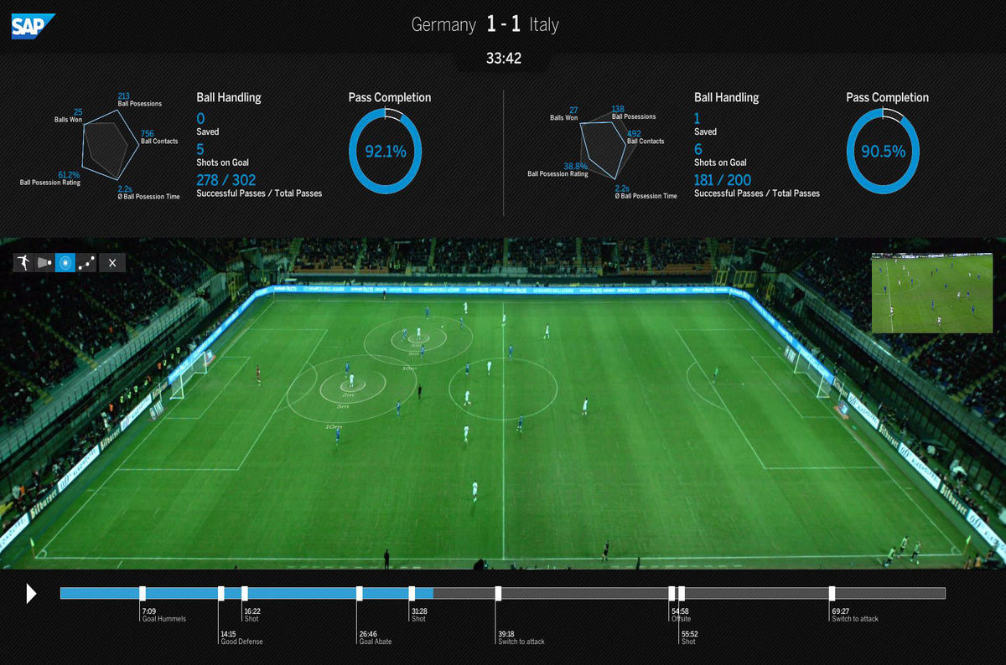

Slide 13
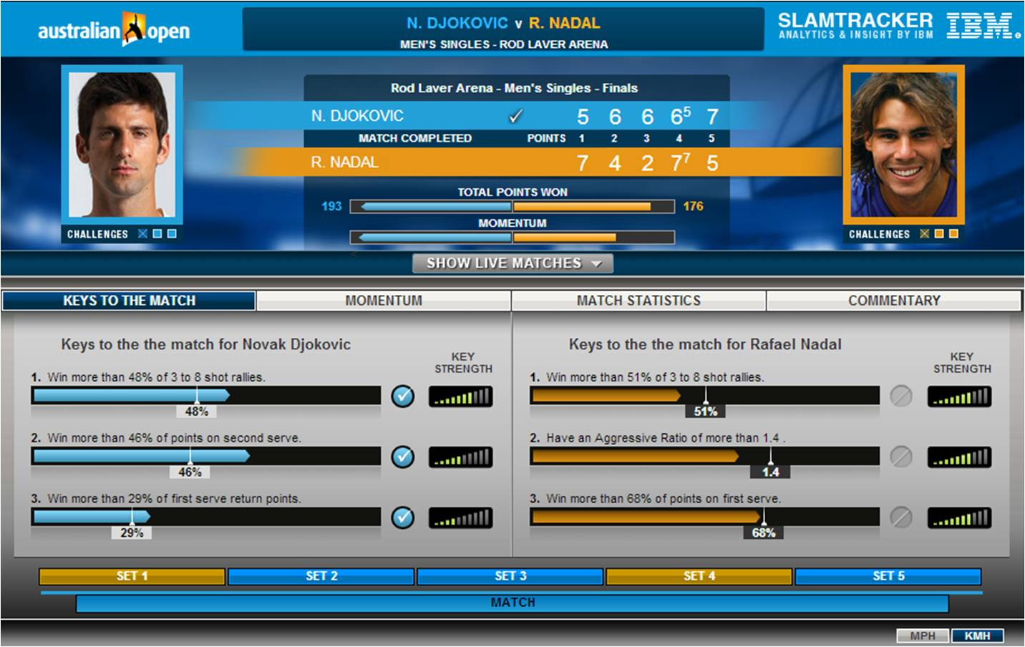
IBM Slam Tracker: This technology aggregated and published a variety of statistics- from a competitor's point-by-point probability of winning the match to his/her opponent's popularity on social media at any given moment.

Slide 14
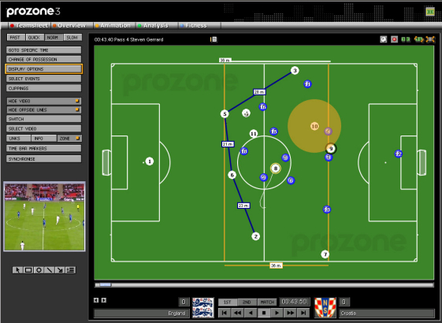
Prozone:
The system by sports analytics provider prozone tracks 10 data points per second for every player, or 1.4 million data points per game. The system is also used to monitor 12,000 soccer matches around the world, which are all analyzed using automated algorithms as well as manual coding.

Slide 15

Conclusion:
(Where we want it to be utilized)
Big data should used in Indian football, as we as a nation have the financial power, so tools mentioned above like wearable technologies, cameras, Match Insights etc need to be introduced for the betterment of our group of players .
As we would be able to analyze every player playing for the nation at each level, so that players know everything about their playing style, their technical ability, their weaknesses so as to eradicate them.
By using big data we will take the standard of Indian football to a whole new level, create a better spectacle for the fans that come to watch their team play and make huge strides in fulfilling the dream of competing in the FIFA WORLD CUP along with the established quality teams the other nations have,and write a new tale in our rich and diversified history.

Slide 16
References:
(1) http://www.forbes.com/sites/bernardmarr/2015/03/25/big-data-the-winning-formula-in-sports/
(2) http://www.huffingtonpost.com/richard-attias/big-data-the-next-revolut_b_5800342.html?
(3) http://www.cio.com/article/2377954/data-management/data-management-8-ways-big-data-and-analytics-will-change-sports.html
(4) http://blogs.wsj.com/cio/2014/07/10/germanys-12th-man-at-the-world-cup-big-data/
(5) http://divante.co/blog/top-20-big-data-cases-sport/

